Slide 1
MULTIPLE DISEASE PREDICTION USING ML
A project by
Name- NILESH GUPT
Roll- 2116117 No.- 2116657
Registration No.- 018667 Session- 2021-22
Course Code- COMSC-H-DSE

Slide 2
INTRODUCTION
A machine learning-based multiple disease prediction system can be incredibly valuable for people who lack access to good medical professionals for several reasons:
1. Early Detection: These systems can help in identifying potential health issues before symptoms become severe. Early detection of diseases like heart disease, diabetes, Parkinson’s, and breast cancer can lead to earlier intervention, which can significantly improve outcomes.
2. Accessibility: For individuals in remote or underserved areas, machine learning tools can provide preliminary diagnostic support without the need for immediate access to specialized healthcare providers. This can bridge gaps where traditional healthcare infrastructure is lacking.
3. Personalized Health Insights: Machine learning models can analyze individual health data and provide personalized risk assessments, guiding users on lifestyle changes and preventive measures specific to their health profile.
4. Scalability: Once developed, these systems can be deployed widely at relatively low cost, making advanced predictive tools available to a large number of people.
5. Continuous Learning: As the model is exposed to more data, it can improve its accuracy and adapt to new patterns, which can be particularly useful in evolving fields like medical research. By leveraging these benefits, a multiple disease prediction system can serve as a supportive tool in managing and potentially preventing serious health conditions, especially in areas where traditional medical resources are scarce.

Slide 3
AIM
The main objective of this project is to make a predictive system using the data available from that will be used to identify and diagnose diseases like breast cancer, diabetes, heart related disease and Parkinson’s disease. The project will focus on developing an interactive and user-friendly platform with React, ensuring a clean, intuitive, and responsive user interface. This interface will include forms for users to input health data like age, weight, medical history, and other relevant metrics.
Appropriate machine learning algorithms will be selected for each disease, such as logistic regression, naive bayes, decision tree classifier and random forest classifier for breast cancer, logistic regression, naive bayes and SVM for diabetes detection, logistic regression and naive bayes for heart disease, and logistic regression and SVM for Parkinson’s disease. These models will be trained using large datasets from medical research databases and validated for accuracy. The trained models will then be evaluated based on their accuracy scores using training dataset and testing dataset. The model with highest accuracy score for that disease will be used to build the predictive system.
The integration and testing phase will connect the React frontend to the backend API, ensuring seamless data exchange between the user interface and the machine learning models. Thorough user testing will be conducted to ensure the system’s usability, accuracy, and reliability, with feedback gathered to refine and improve the user experience. Performance optimization will be carried out To ensure the application can handle a large number of users and data inputs efficiently.

Slide 4
AIM
The React-based platform will be designed to be user-friendly and highly interactive, ensuring that users can easily navigate and input their health data. The system will utilize advanced machine learning algorithms to analyze this data and provide accurate predictions. By identifying potential health issues early, users can take timely action, seeking medical advice and interventions that can significantly improve their health outcomes.

Slide 5
PREVIOUS WORKS
The SVM method and the Nave Bayes technique were used to predict kidney disease. The authors attempted to categorize various stages of kidney disease using the suggested ANFIS algorithm. The study’s purpose was to design an effective categorization algorithm using several assessment metrics such as accuracy and execution time. While the SVM Algorithm provided higher classification accuracy, the Nave Bayes fared better since it produced results in less time. The results show that SVM outperforms the Nave Bayes Approach in predicting renal illness.
The fuzzy technique with a membership function was used to forecast cardiac disease. Using the Fuzzy KNN Classifier, the authors attempted to eliminate ambiguity and uncertainty from data. The 550-record dataset was separated into 25 classes, with each class having 22 items. The dataset was separated into two equal parts: training and testing. The fuzzy KNN methodology was implemented after pre-processing techniques were used. This technique was examined using several assessment metrics such as accuracy, precision, and recall, among others. Based on the data, it was discovered that the fuzzy KNN classifier outperformed the KNN classifier in terms of accuracies.
For the prediction of cardiac disease, a novel technique based on the ANN algorithm was devised. The researchers created an interactive prediction method based on categorization using an artificial neural network algorithm and taking into account the thirteen most important clinical parameters. The suggested method proved effective for predicting heart disease with an accuracy of 80% and can be very useful for healthcare practitioners.
Diabetes and breast cancer were diagnosed by incorporating the adaptivity characteristic into support vector machines. The goal was to offer a rapid, automated, and adaptable diagnostic method using adaptive SVM. To achieve better results, the bias value in conventional SVM was changed. The suggested classifier produced output in the form of ‘if-then’ rules. The proposed method was used to diagnose diabetes and breast cancer, and it provided 100% right classification rates for both conditions. Future research should focus on developing more efficient ways for changing the bias value in conventional SVM.
For the prediction of type 2 diabetes, a hybrid model based on clustering followed by classification was proposed. For prediction, the suggested model uses K-means clustering and the C4.5 classification method with k-fold cross-validation. The model generated encouraging results with a classification accuracy of 88.38% using the hybrid technique, which might be highly useful for clinicians in making appropriate clinical choices related to diabetes.

Slide 6
METHODOLOGIES
Machine Learning (ML) is a subset of artificial intelligence (AI) that focuses on building systems that can learn from and make decisions based on data. It involves algorithms that improve their performance over time as they are exposed to more data.
Supervised Learning is a type of ML where the model is trained on labeled data. This means that each training example is paired with an output label. The model learns to map inputs to the correct outputs and can be used for tasks like classification and regression.
Logistic Regression is a supervised learning algorithm used for binary classification tasks. It estimates the probability of a binary outcome based on one or more predictor variables. The output is a value between 0 and 1, interpreted as the probability of the positive class.
Support Vector Machine (SVM) is a supervised learning algorithm used for classification and regression tasks. It finds the hyperplane that best separates different classes in the feature space. SVM can handle both linear and non-linear relationships by using kernel functions to transform the data.
Decision Tree Classifier is a supervised learning algorithm that splits the data into subsets based on the values of input features. It uses a tree-like model of decisions and their possible consequences. Each internal node represents a decision based on an attribute, and each leaf node represents a class label.
Random Forest Classifier is an ensemble learning method that combines multiple decision trees to improve classification accuracy. Each tree is trained on a random subset of the data and features. The final prediction is made by aggregating the predictions from all the trees, usually by majority vote.
Naive Bayes is a family of probabilistic classifiers based on Bayes’ theorem with the assumption of independence between features. It is particularly useful for large datasets and text classification tasks. Despite its simplicity, it can be quite effective for many problems.

Slide 7
Existing System
The existing system focuses on predicting diabetes, heart disease, and Parkinson’s disease using a variety of machine learning algorithms, including Naïve Bayes, Decision Trees, Random Forest, SVM, and Logistic Regression.
SVM achieved 76% accuracy in diabetes prediction and 71% in Parkinson’s disease, highlighting its effectiveness.
Other algorithms like logistic regression and Decision Trees are also employed, each leveraging distinct data characteristics for accurate predictions. Overall, the system demonstrates the potential of ML algorithms in disease prediction, with further enhancements to improve accuracy.

Slide 8
SCOPE OF IMPROVEMENT
SVM achieved 76% accuracy in diabetes prediction and 71% in Parkinson’s disease, which may not be sufficient for clinical use where higher accuracy is crucial.
Other algorithms’ accuracy levels are not mentioned, and they might be lower, which could affect overall reliability.
While Streamlit offers a user-friendly interface, it might not provide the necessary flexibility and customization required for more complex user interactions or integration with other tools.

Slide 9
PROPOSED SYSTEM
The proposed methodology for this project involves leveraging multiple training models for disease prediction, where their performances are compared.
This process involves utilizing various libraries like pandas for data handling, numpy for numerical operations, scikit-learn for model training and evaluation, and pickle for exporting the trained model for future application use. Additionally, the approach enables the simultaneous prediction of multiple diseases, streamlining the prediction process for users. Compared to existing systems, this method offers faster predictions and numerous advantages, contributing to improved healthcare outcomes.
For the front end React.js is used over Streamlit. React.js, being a highly flexible and widely adopted JavaScript library for building user interfaces, provides developers with the tools to create dynamic and responsive web applications. Unlike Streamlit, which is primarily designed for creating data- driven web apps quickly and with minimal code, React.js offers a more comprehensive and customizable approach. This flexibility is crucial for building complex interfaces where user experience and interactivity are paramount.

Slide 10
ADVANTAGES OF PROPOSED SYSTEM
Using React.js over Streamlit for the user interface of a disease prediction system offers several significant advantages, enhancing both the functionality and user experience of the application
Additionally, the approach enables the simultaneous prediction of multiple diseases, streamlining the prediction process for users and potentially reducing mortality rates. Compared to existing systems, this method offers faster predictions and numerous advantages, contributing to improved healthcare outcomes.
The proposed system add one more disease, that is Breast Cancer.

Slide 11
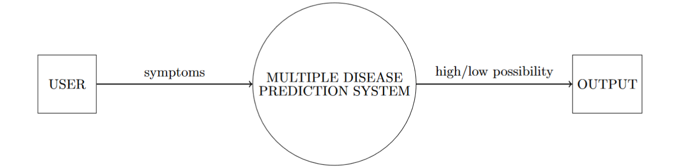
DFD
LEVEL 0:

Slide 12
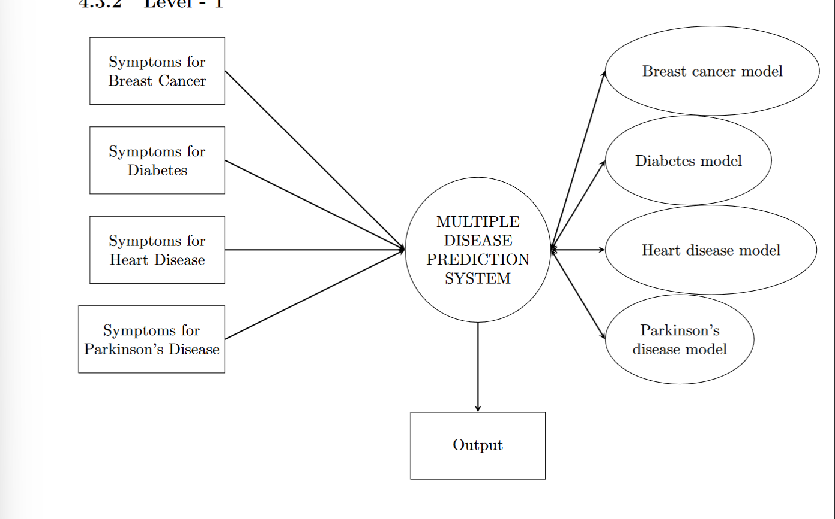
DFD
LEVEL 1:

Slide 13
IMPLEMENTATION
DATASET COLLECTION:
BREAST CANCER DATASET
DIABETES DATASET
HEART DISEASE DATASET
PARKINSON’S DISEASE DATASET
MODEL TRAINING
MODEL EVALAUTION
BUILDING FRONTEND
BUILDING BACKEND

Slide 14
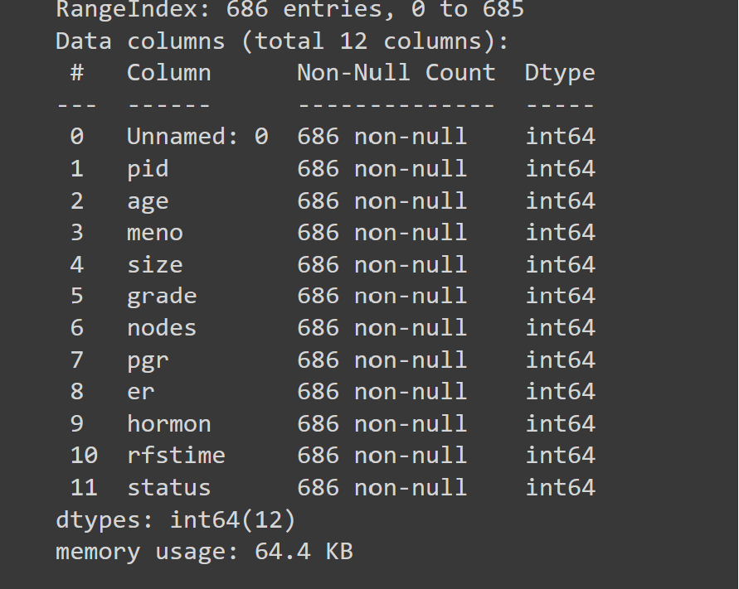
BREAST CANCER DATASET
The data set contains patient records from a 1984-1989 trial conducted by the German Breast Cancer Study Group (GBSG) of 720 patients with node positive breast cancer; it retains the 686 patients with complete data for the prognostic variables. These data sets are used in the paper by Royston and Altman(2013). The Rotterdam data is used to create a fitted model, and the GBSG data for validation of the model. The paper gives references for the data source.

Slide 15
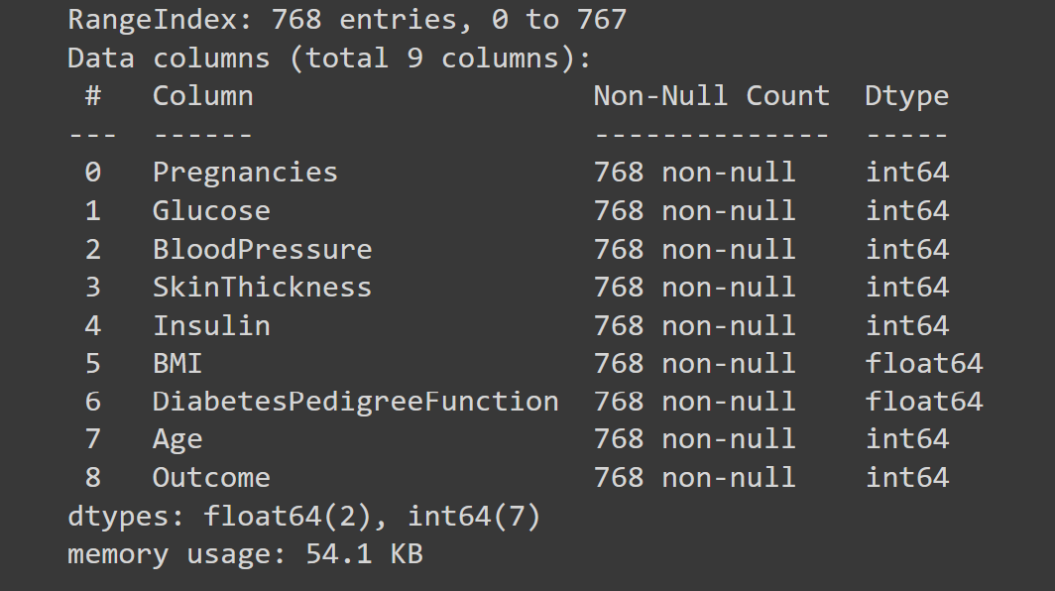
DIABETES DATASET
The dataset contains features such as number of pregnancies, glucose, blood pressure, skin thickness, insulin, body mass index (BMI) and age.

Slide 16
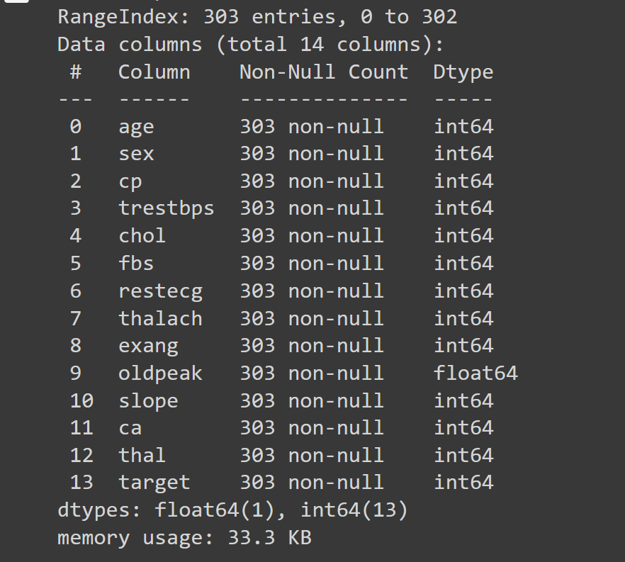
HEART DISEASE DATASET
The dataset contains features such as age, sex, cholesterol, resting blood pressure, fasting glucose levels, resting electrocardiographic measurement, maximum heart rate achieved, Exercise induced angina, calcium and thalassemia.

Slide 17
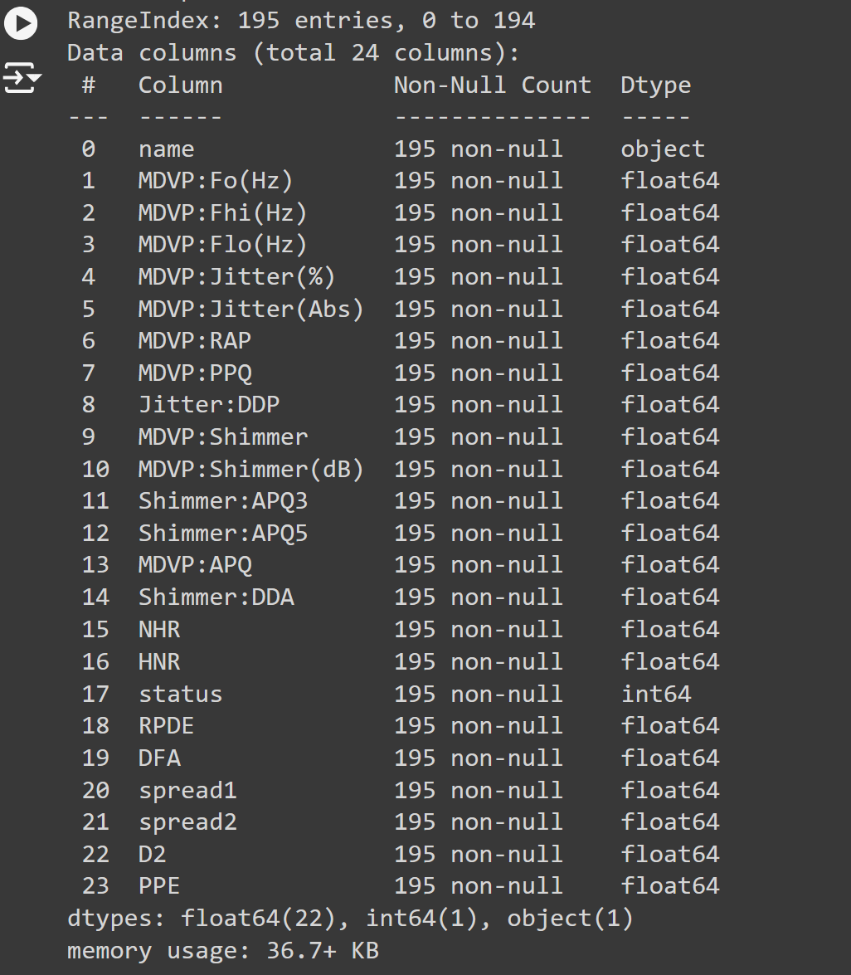
PARKINSON’S DISEASE DATASET
The dataset was created by Max Little of the University of Oxford, in collaboration with the National Centre for Voice and Speech, Denver, Colorado, who recorded the speech signals. The original study published the feature extraction methods for general voice disorders. This dataset is composed of a range of biomedical voice measurements from 31 people, 23 with Parkinson’s disease (PD). Each column in the table is a particular voice measure, and each row corresponds one of 195 voice recording from these individuals (”name” column).
The main aim of the data is to discriminate healthy people from those with PD, according to ”status” column which is set to 0 for healthy and 1 for PD.

Slide 18
MODEL TRAINING
Various machine learning models are employed to predict different diseases based on the provided dataset. Specifically:
Support Vector Machine (SVM) is used for predicting Breast Cancer, Parkinson’s Disease, and Diabetes.
Logistic Regression is applied across all diseases.
Naïve Bayes is utilized for predicting Breast Cancer, Diabetes, and Heart Disease.
Decision Tree Classifier and Random Forest Classifier are both used for predicting Breast Cancer.

Slide 19
ACCURACY SCORES OF THE MODELS
BREAST CANCER PREDICTION:
ALGORITHM USED | ACCURACY SCORE
LOGISTIC REGRESSION | 77%
NAÏVE BAYES | 68%
DECESION TREE CLASSIFIER | 62%
RANDOM FOREST CLASSIFIER | 80%
SVM | 75%

Slide 20
DIABETES PREDICTION:
HEART DISEASE PREDICTION:
ALGORITHM USED | ACCURACY SCORE
LOGISTIC REGRESSION | 76%
NAÏVE BAYES | 77%
SVM | 77%
ALGORITHM USED | ACCURACY SCORE
LOGISTIC REGRESSION | 84%
NAÏVE BAYES | 85%

Slide 21
PARKINSON’S DISEASE PREDICTION:
ALGORITHM USED | ACCURACY SCORE
LOGISTIC REGRESSION | 86%
SVM | 90%

Slide 22
SUMMURY
The fields of disease diagnosis and prediction hold significant potential for transformation through ML techniques.
Accuracy and correctness in diagnosis are most important aspects in effective treatment procedures for managing sickness.
In our system, we employ the Random forest classifier for breast cancer, Naïve Bayes algorithm for heart disease, SVM for diabetes and Parkinson’s disease for prediction. Patients input values into the system to determine disease presence.
The accuracy of predictions relies on the machine learning algorithm’s ability to retrieve precise outputs.

Slide 23
FRONTEND
A react.js file named ’App.jsx’ is created which holds the path to other application for diseases.This file defines the App component for a React application.
The App component serves as the main container for the user interface, including navigation and different disease prediction forms. The component imports several dependencies, including React for building the UI, various disease-specific components like Diabetes, Heart Disease, Breast Cancer, and Parkinson’s, and a Sidebar component for navigation. It also imports a CSS file for styling.
Inside the App component, a state variable called ’selectedOption’ is used to track the currently selected disease prediction form. This state is initialized to display the ”Diabetes Prediction” form by default. The ’setSelectedOption’ function is used to update this state based on user interaction. ’Sidebar.jsx’ is the main gateway to different disease pages. The component renders a Sidebar component, which provides navigation options. Based on the value of selectedOption, the component conditionally renders the corresponding disease prediction form.
If ”Diabetes Prediction” is selected, the Diabetes component is shown. Similarly, the Heart Disease, Breast Cancer, or Parkinson’s components are rendered based on the user’s selection. The App component is exported as the default export, making it available for use in other parts of the application. Overall, this file defines the primary structure and functionality for switching between different disease prediction forms in the application, handling user selection throughthe Sidebar, and managing the content displayed based on the user’s choice.

Slide 24
BACKEND
Flask is a lightweight Python web framework for building web applications. It provides essential tools for routing, request handling, and templating, allowing developers to create flexible and scalable applications. Its minimalist approach gives developers control over the project structure, making it suitable for small to medium-sized projects.
In this project, the data provided by the user at the ’App.jsx’ file is fetched.
At the backend, all trained machine learning models are loaded using pickle or joblib, and the are provided with the data of the specific disease.
The model then makes a prediction and a value (0/1) is generated. The python file then return a result in statement whether there is a probability of the disease from the given symptoms or not.

Slide 25
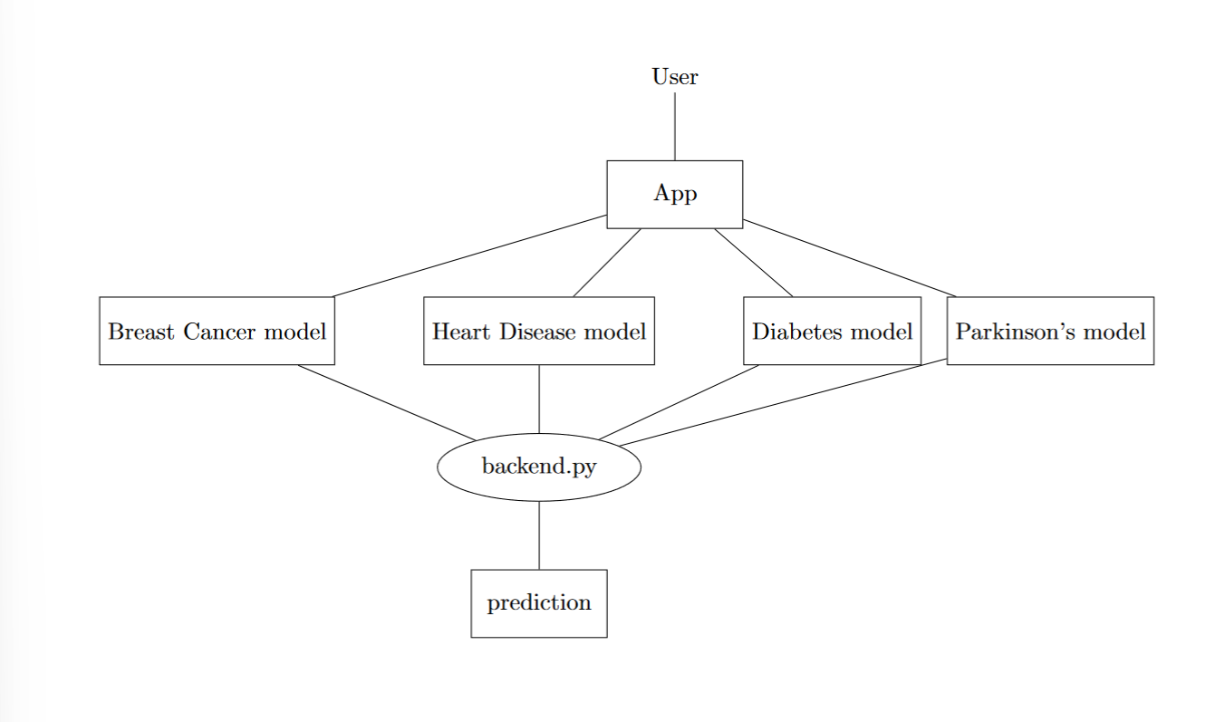
UML (Unified Modeling Language) DIAGRAM

Slide 26
SCREENSHOTS

Slide 27
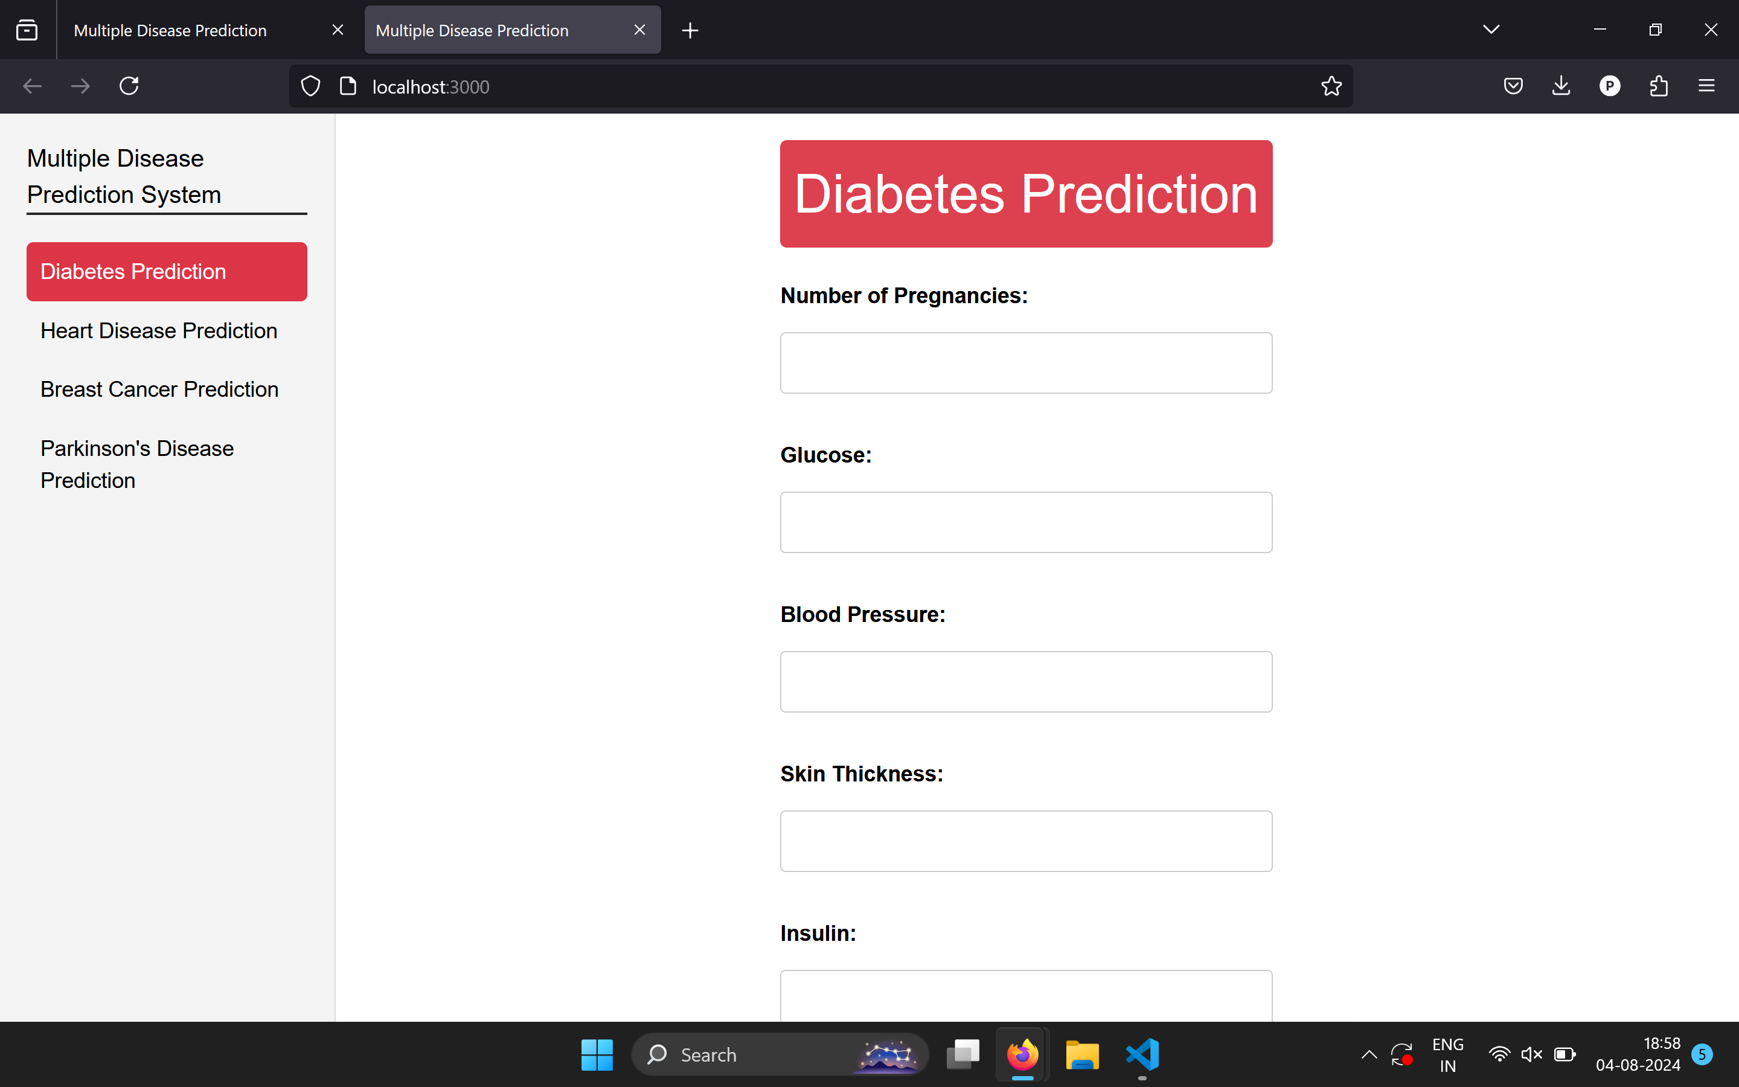
DIABETES

Slide 28
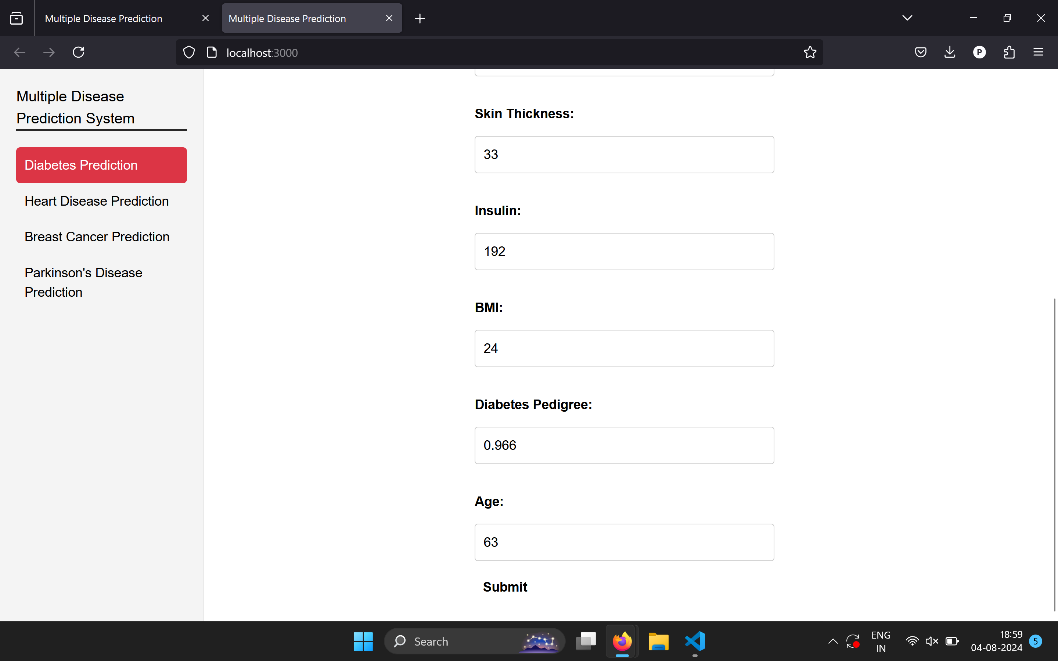

DIABETES
INPUT

Slide 29
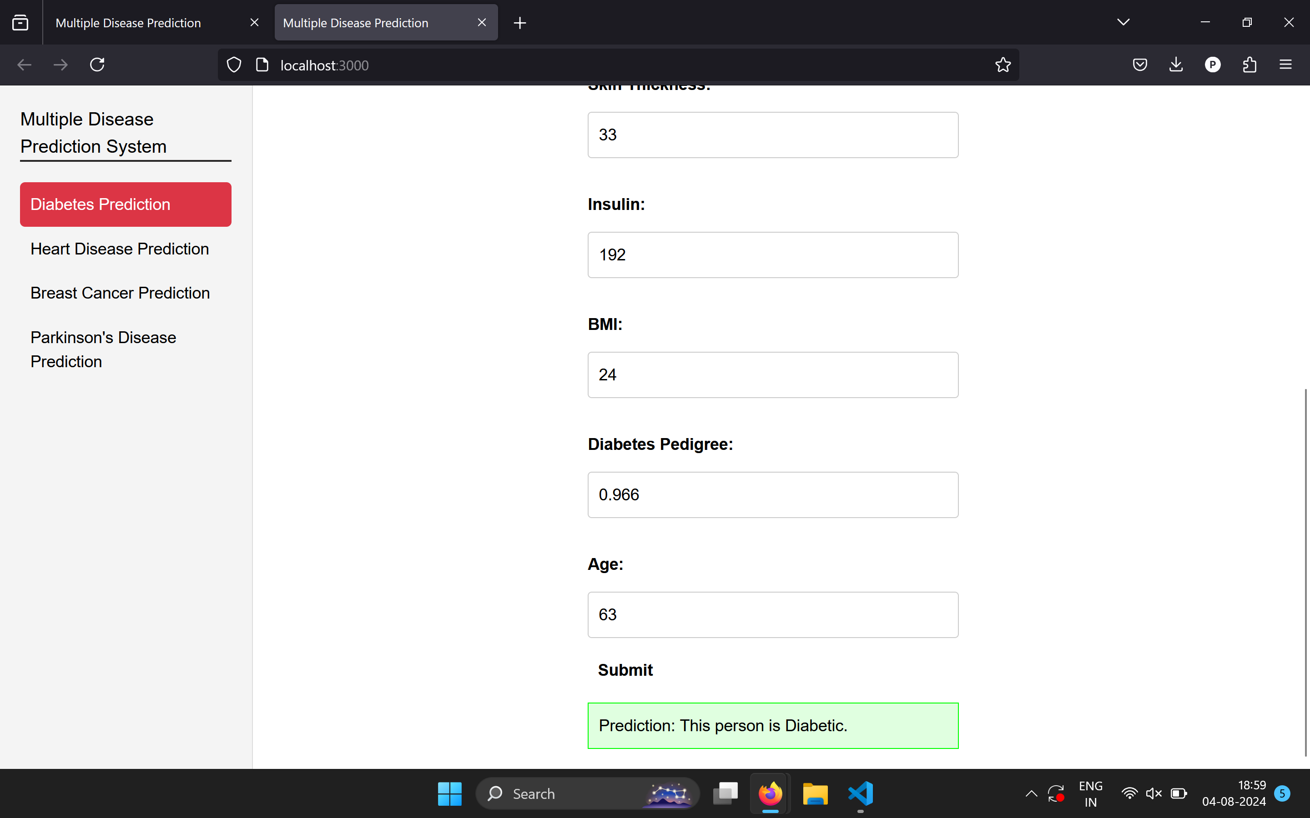
DIABETES
OUTPUT

Slide 30
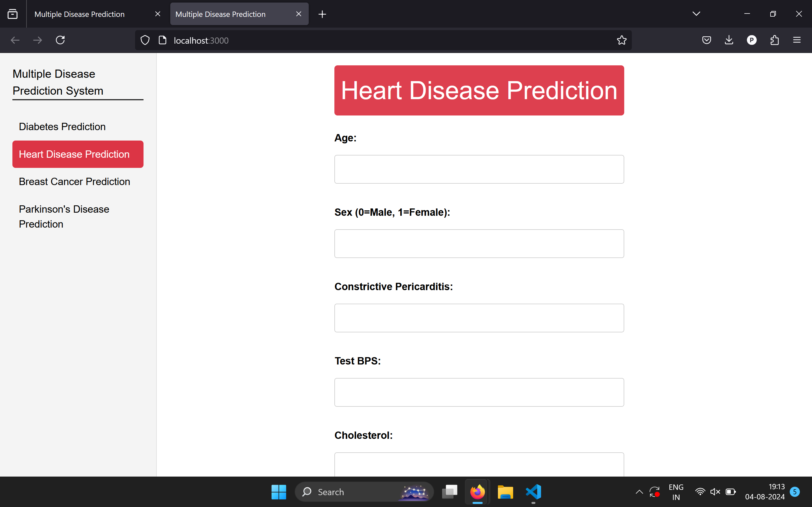
HEART DISEASE

Slide 31
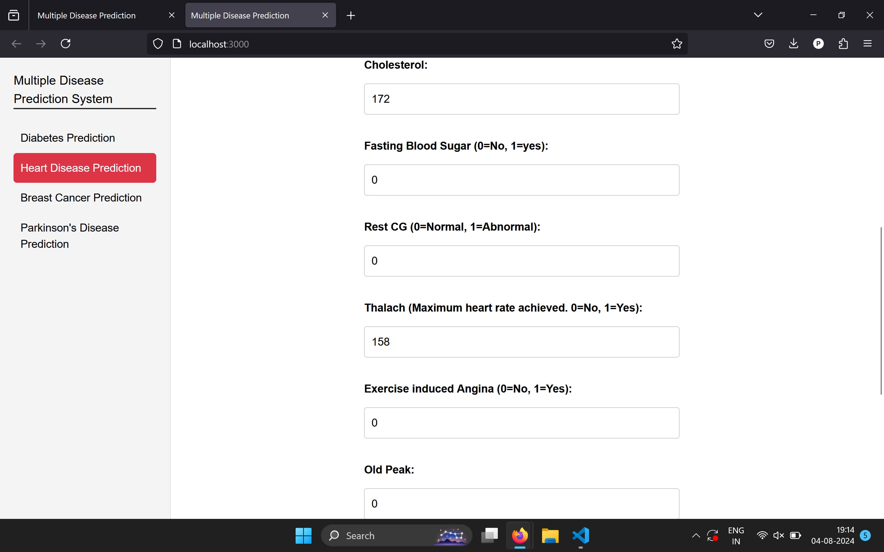

HEART DISEASE
INPUT

Slide 32
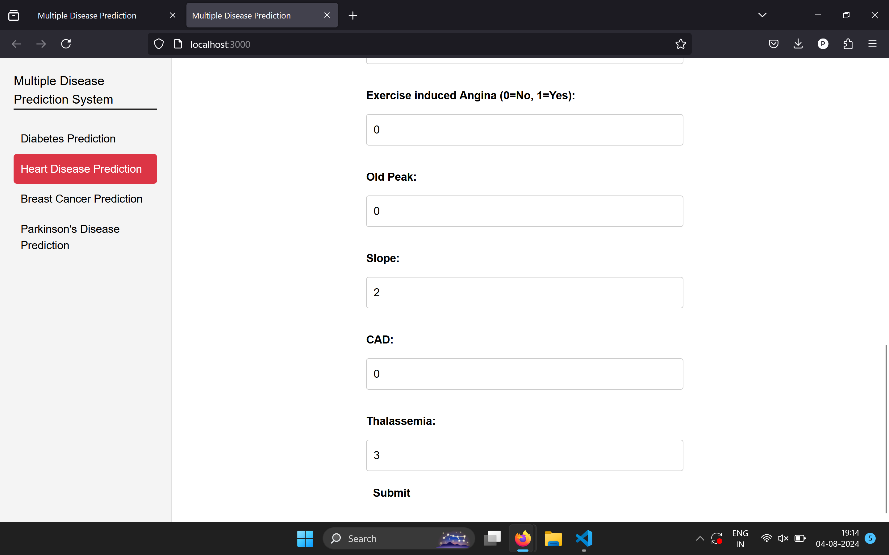
HEART DISEASE
INPUT

Slide 33
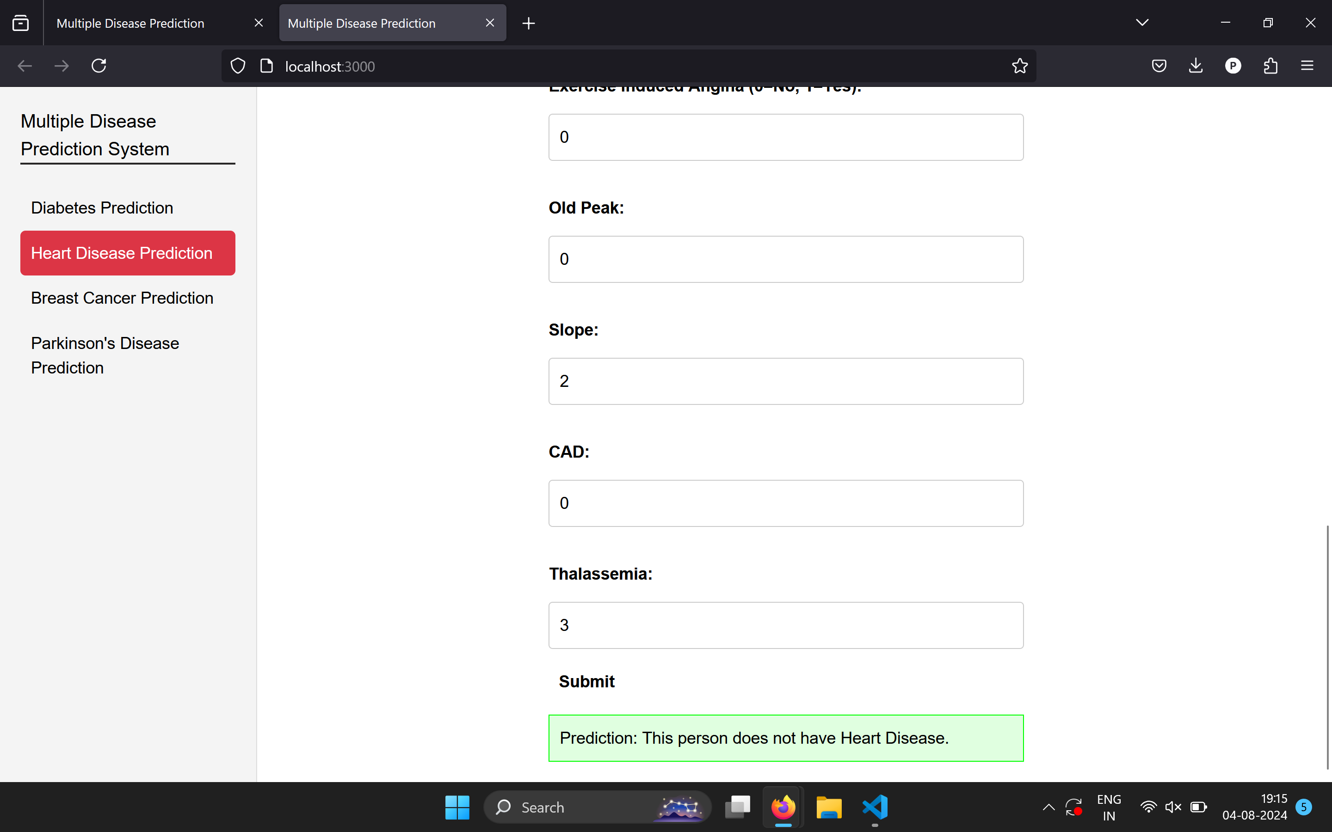
HEART DISEASE
OUTPUT

Slide 34
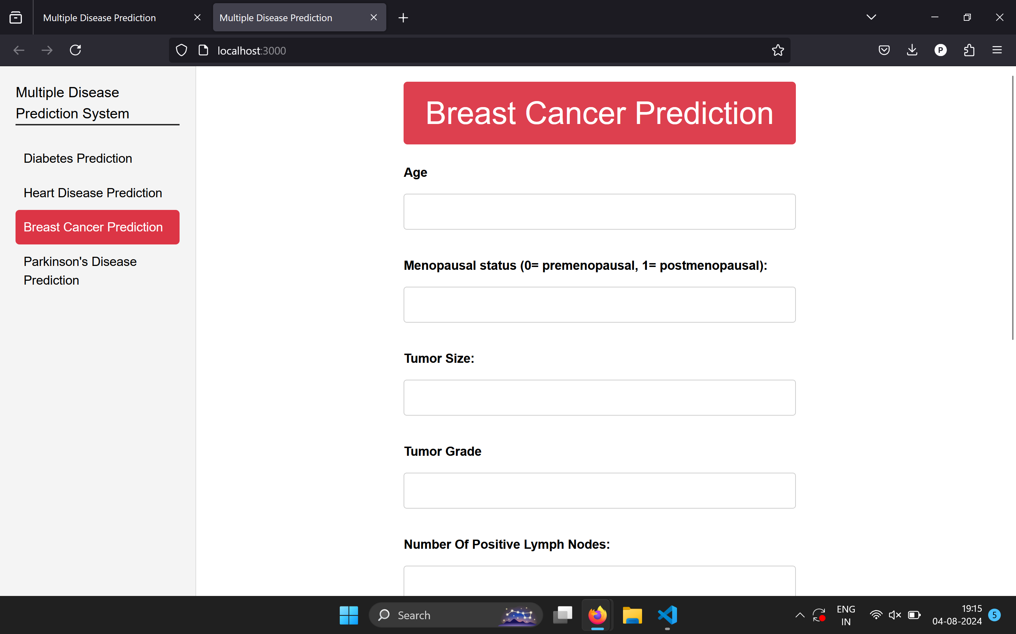
BREAST CANCER

Slide 35
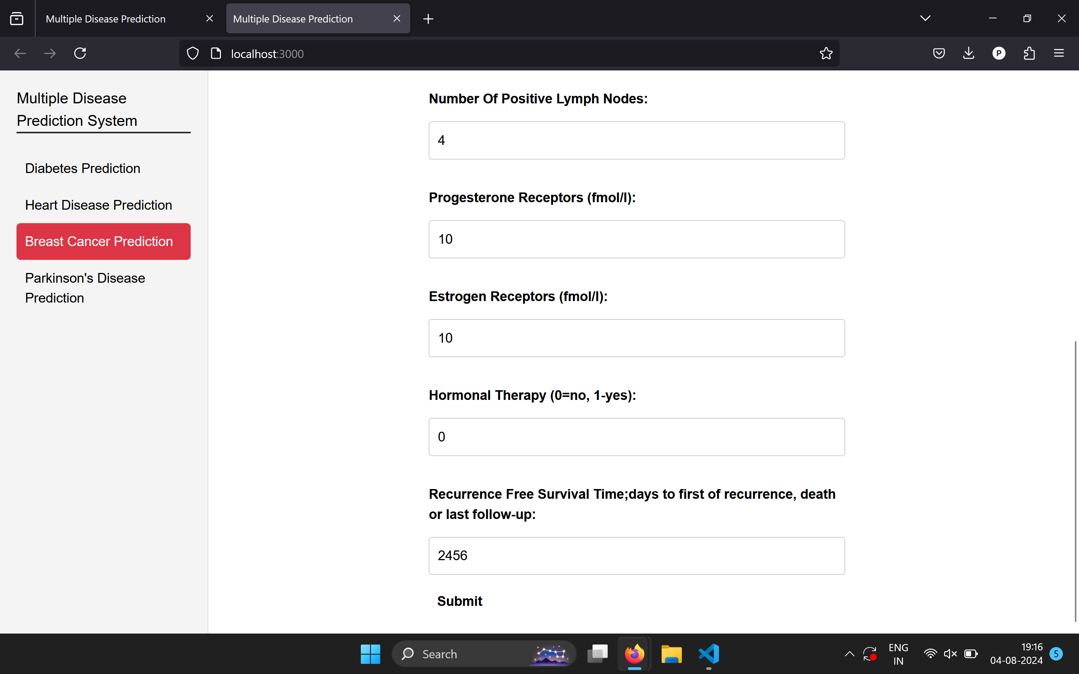

BREAST CANCER
INPUT

Slide 36
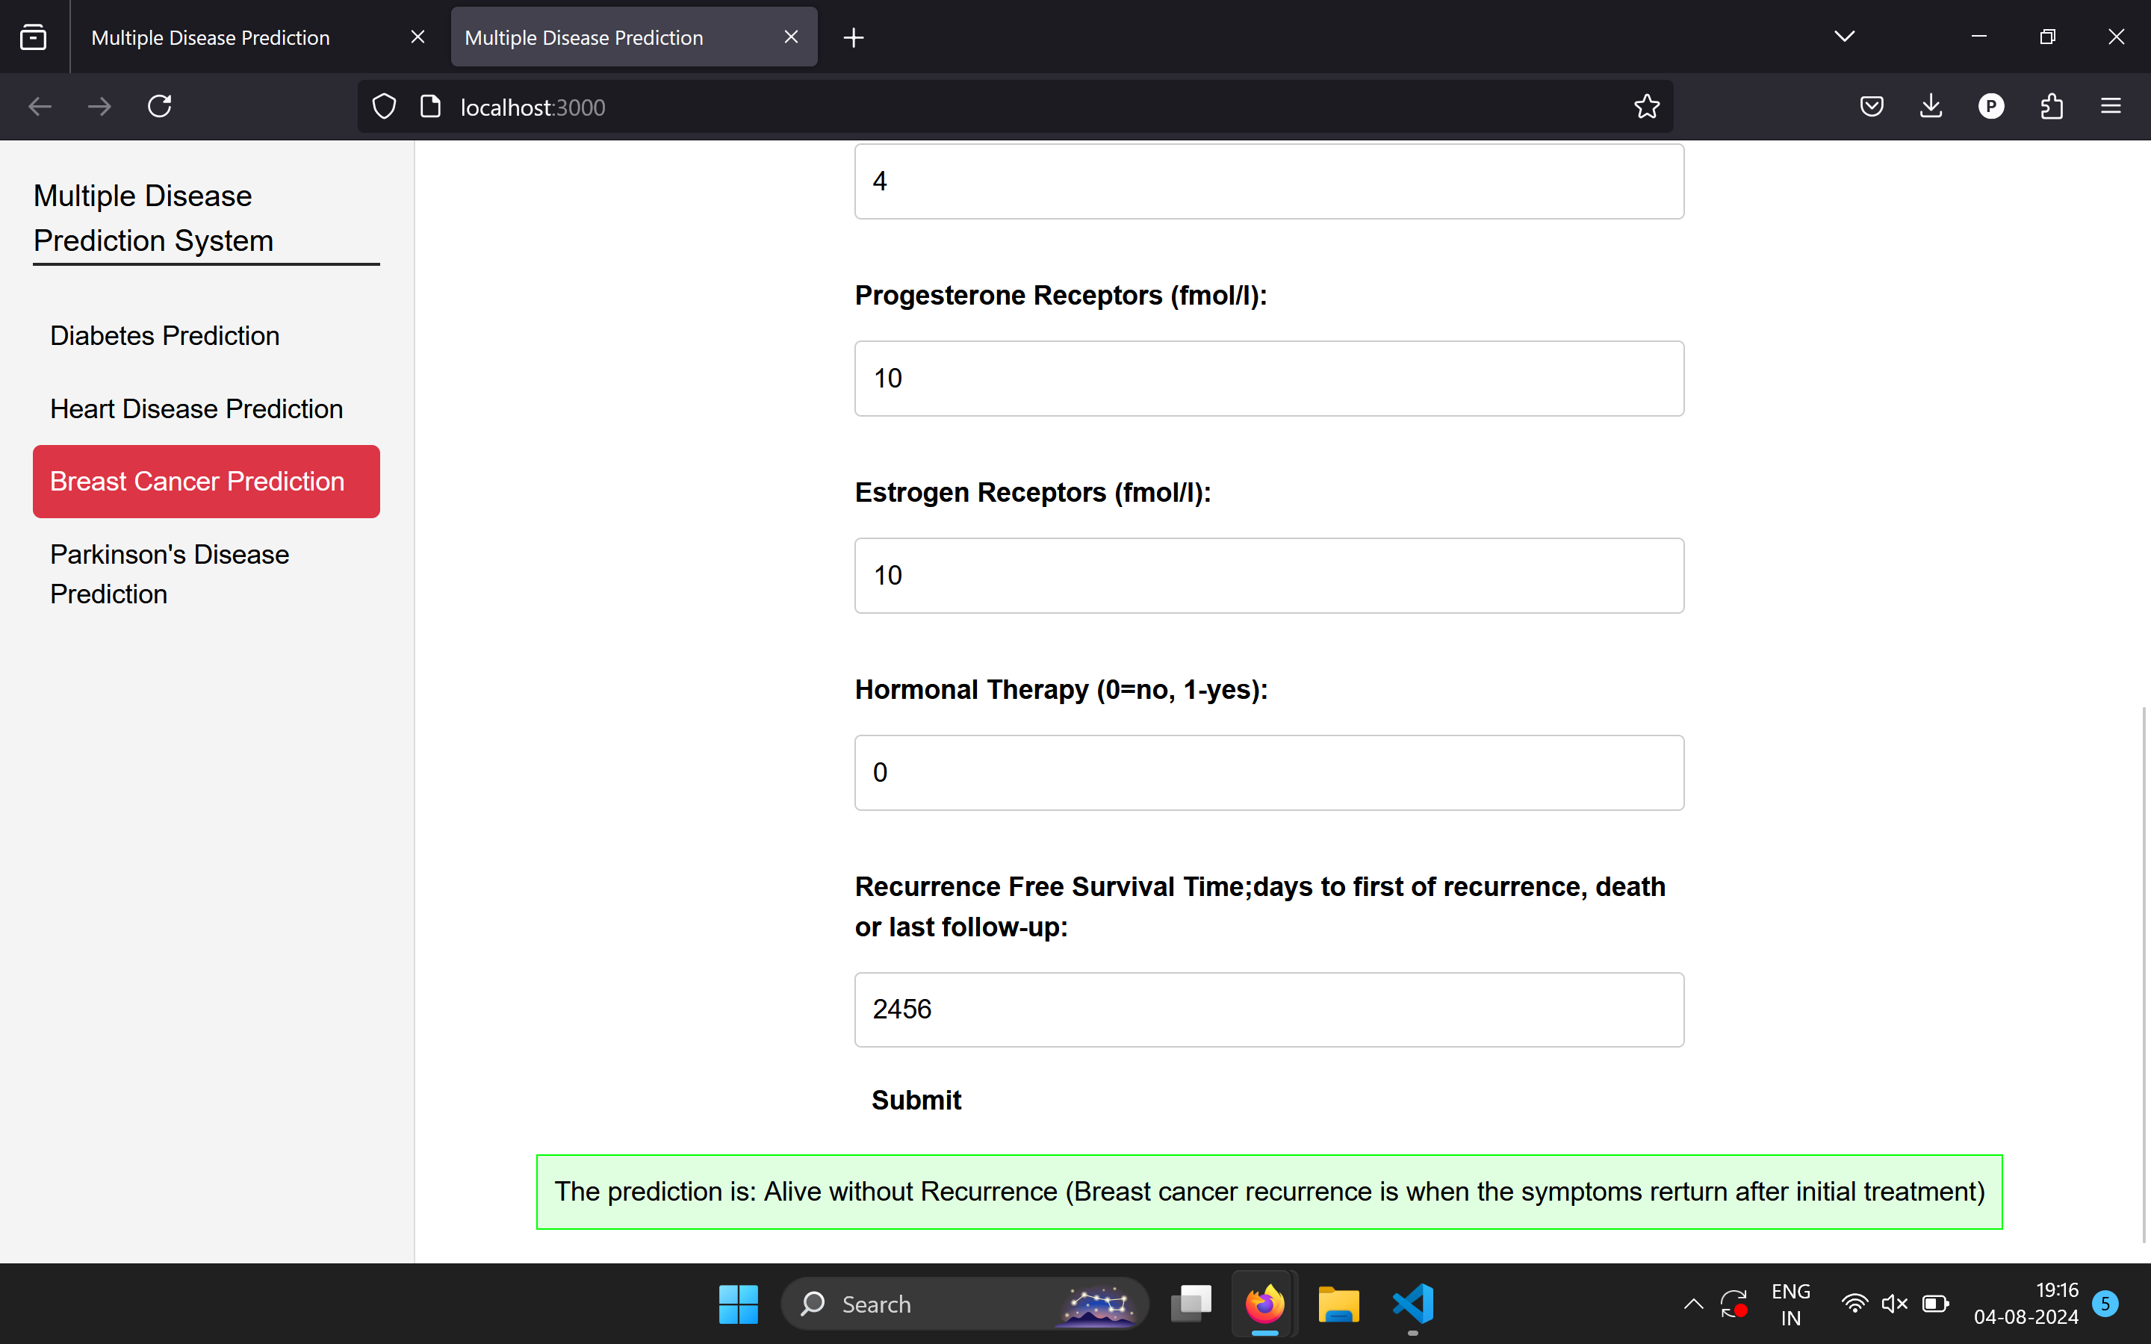
BREAST CANCER
OUTPUT

Slide 37
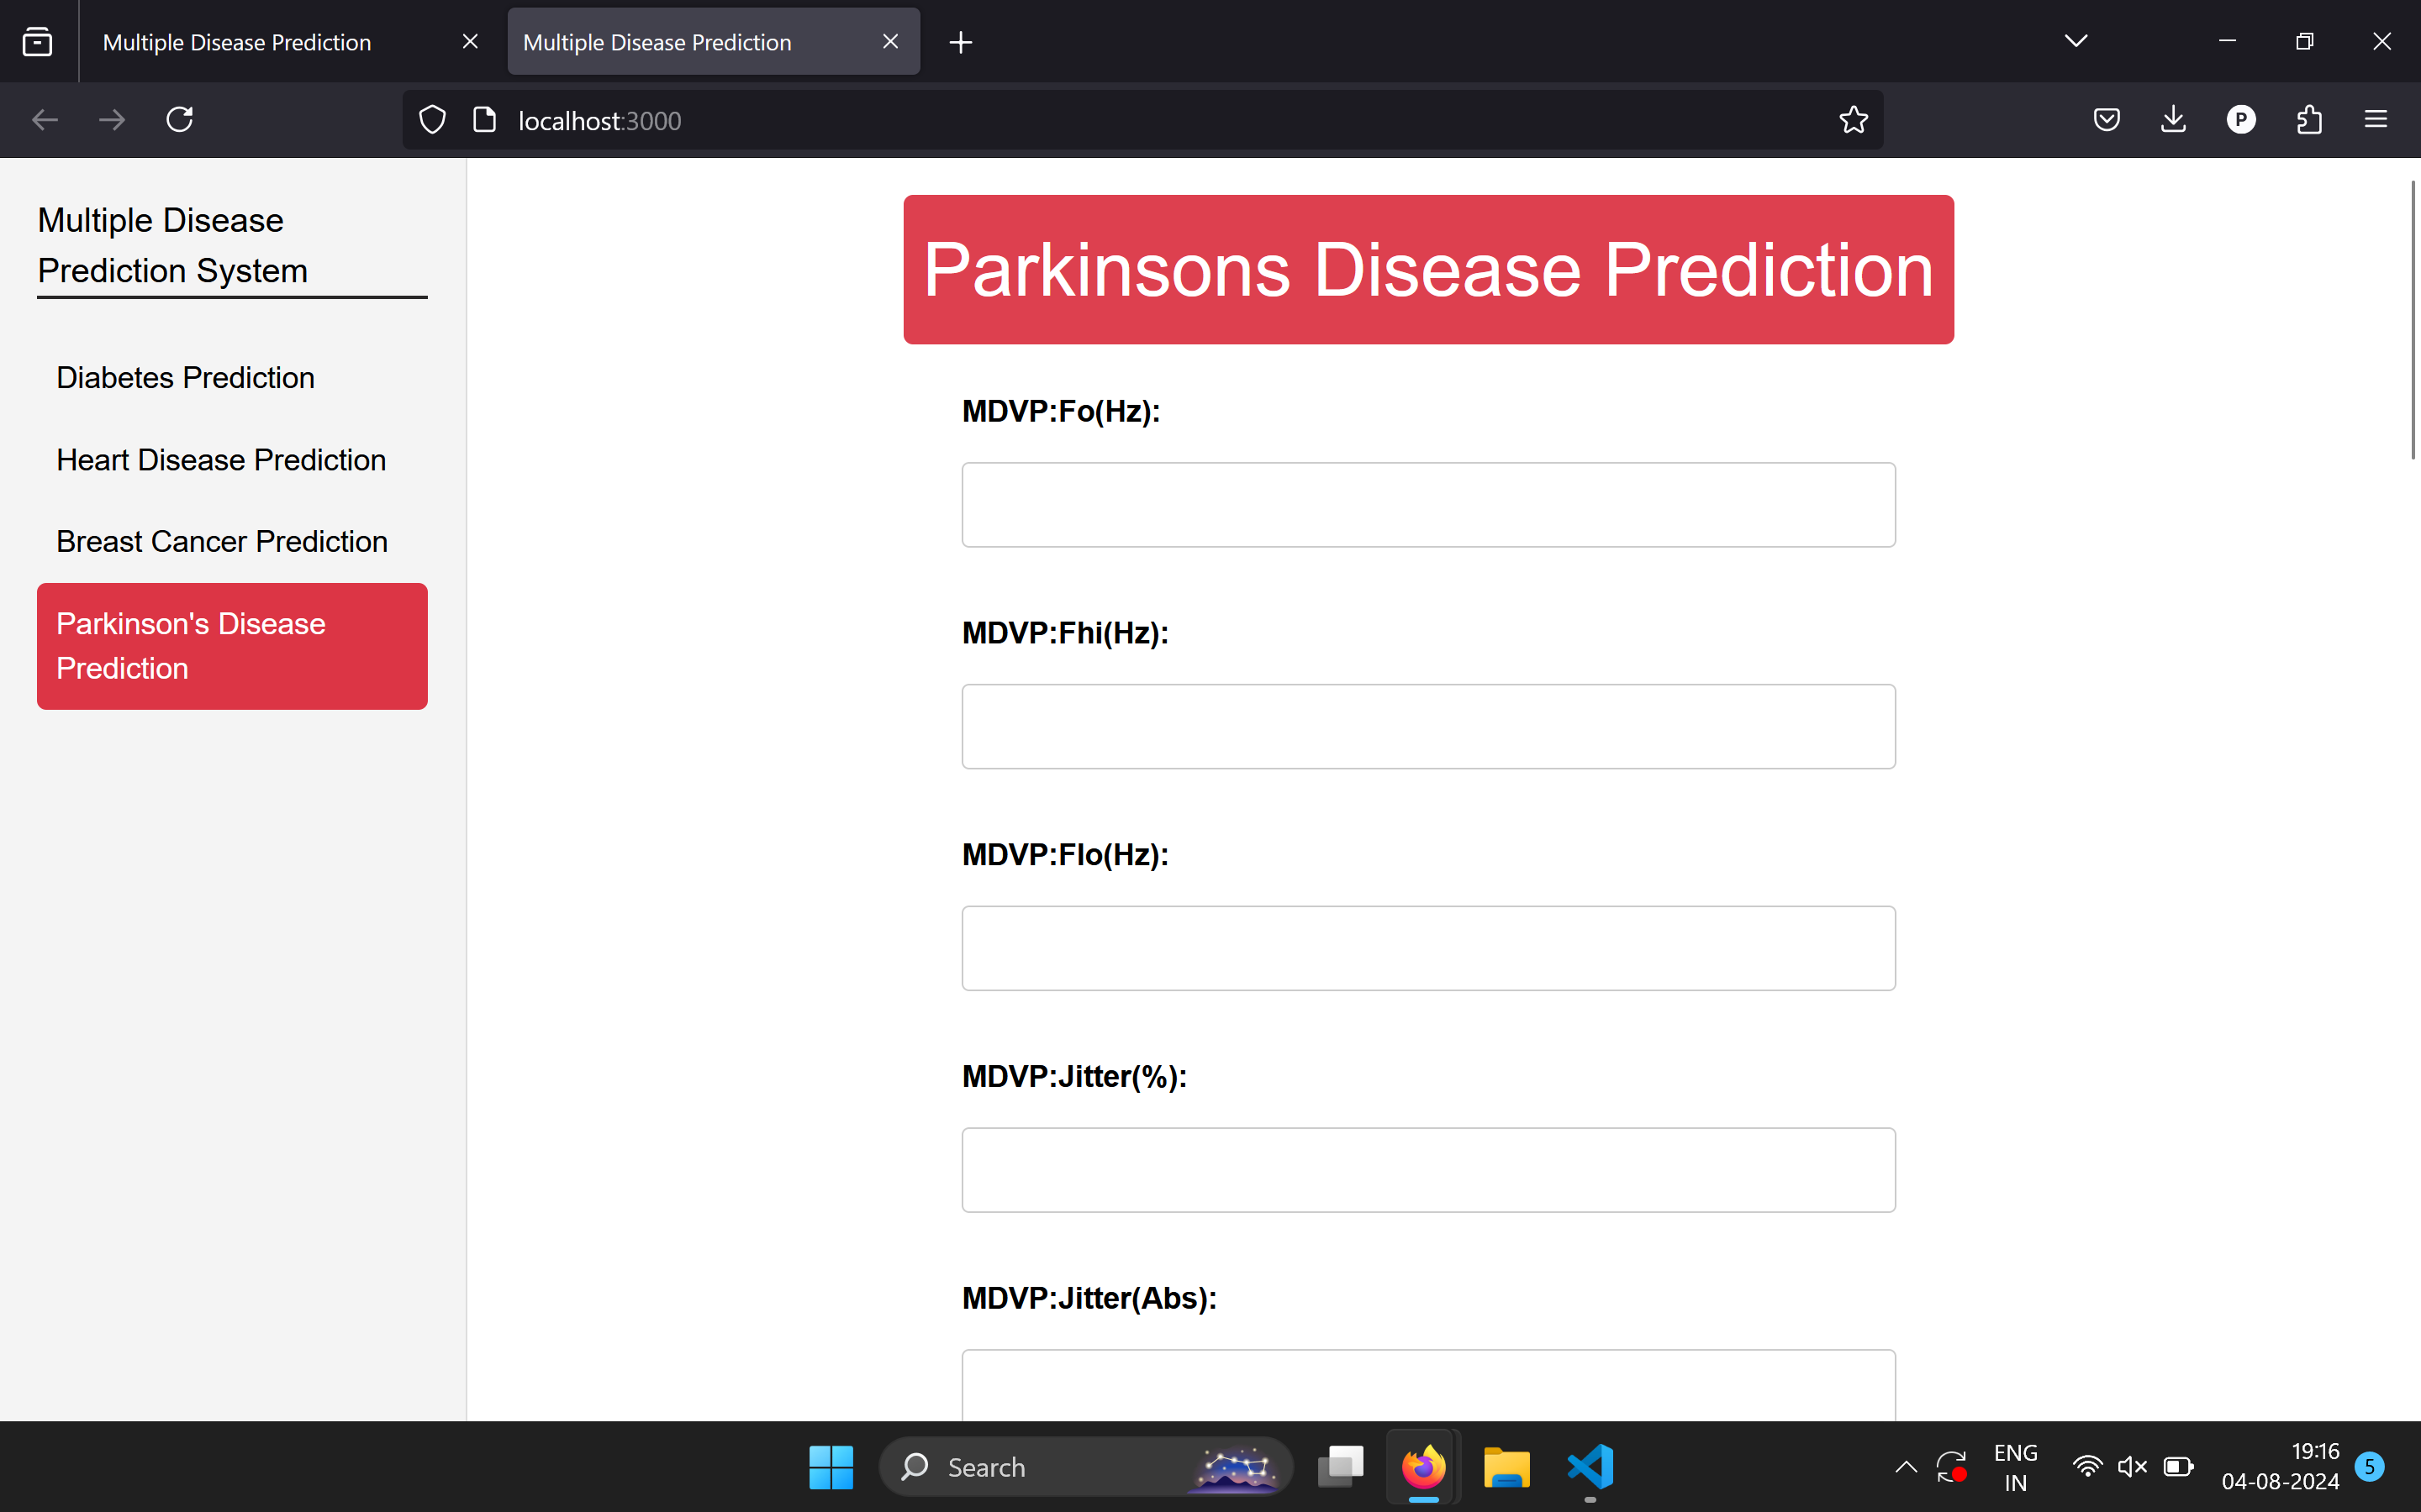
PARKINSON’S DISEASE

Slide 38
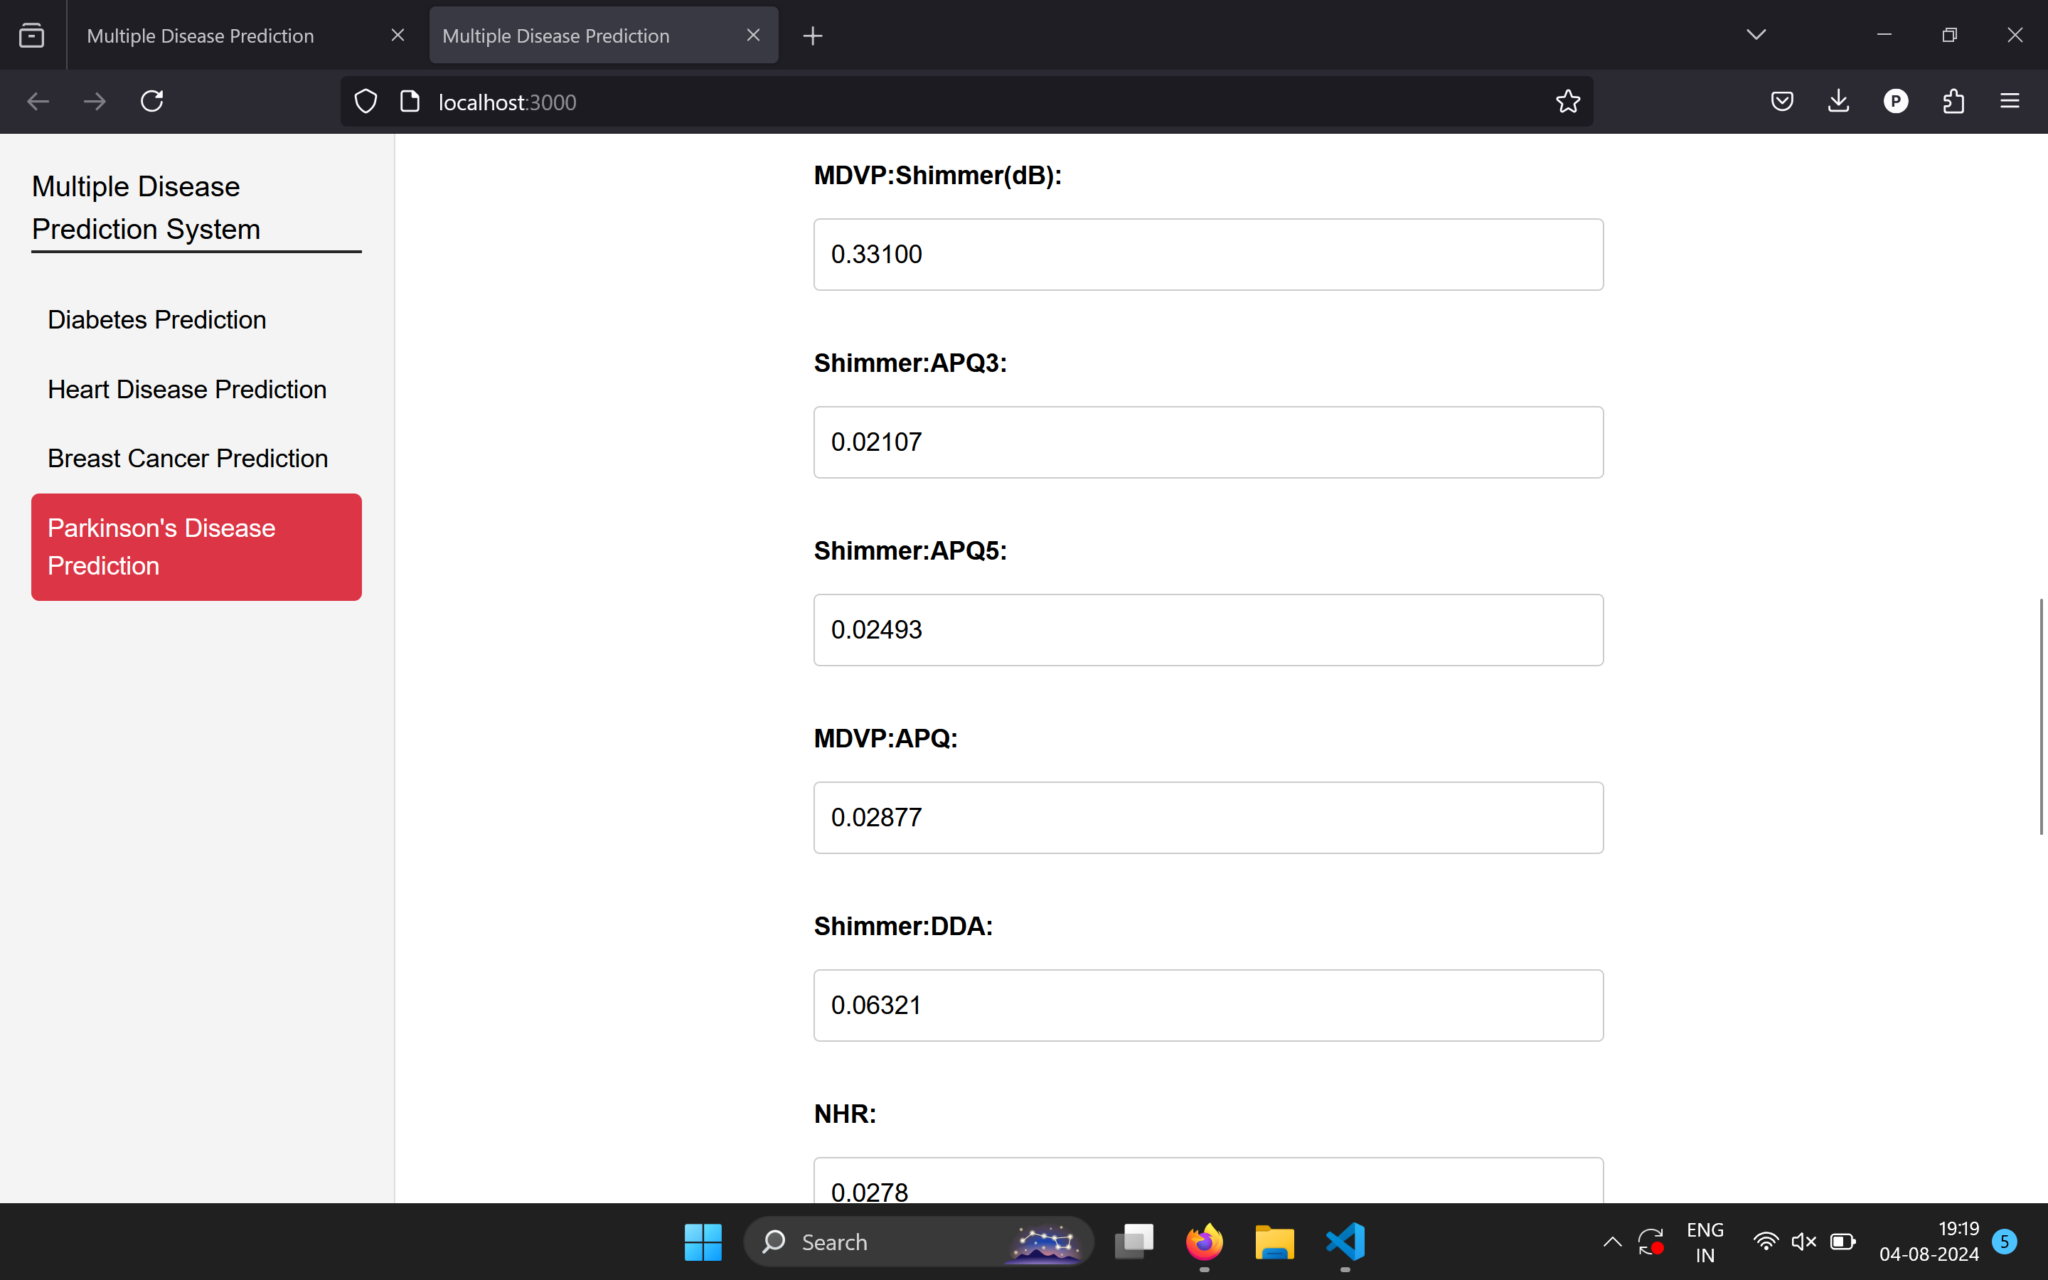
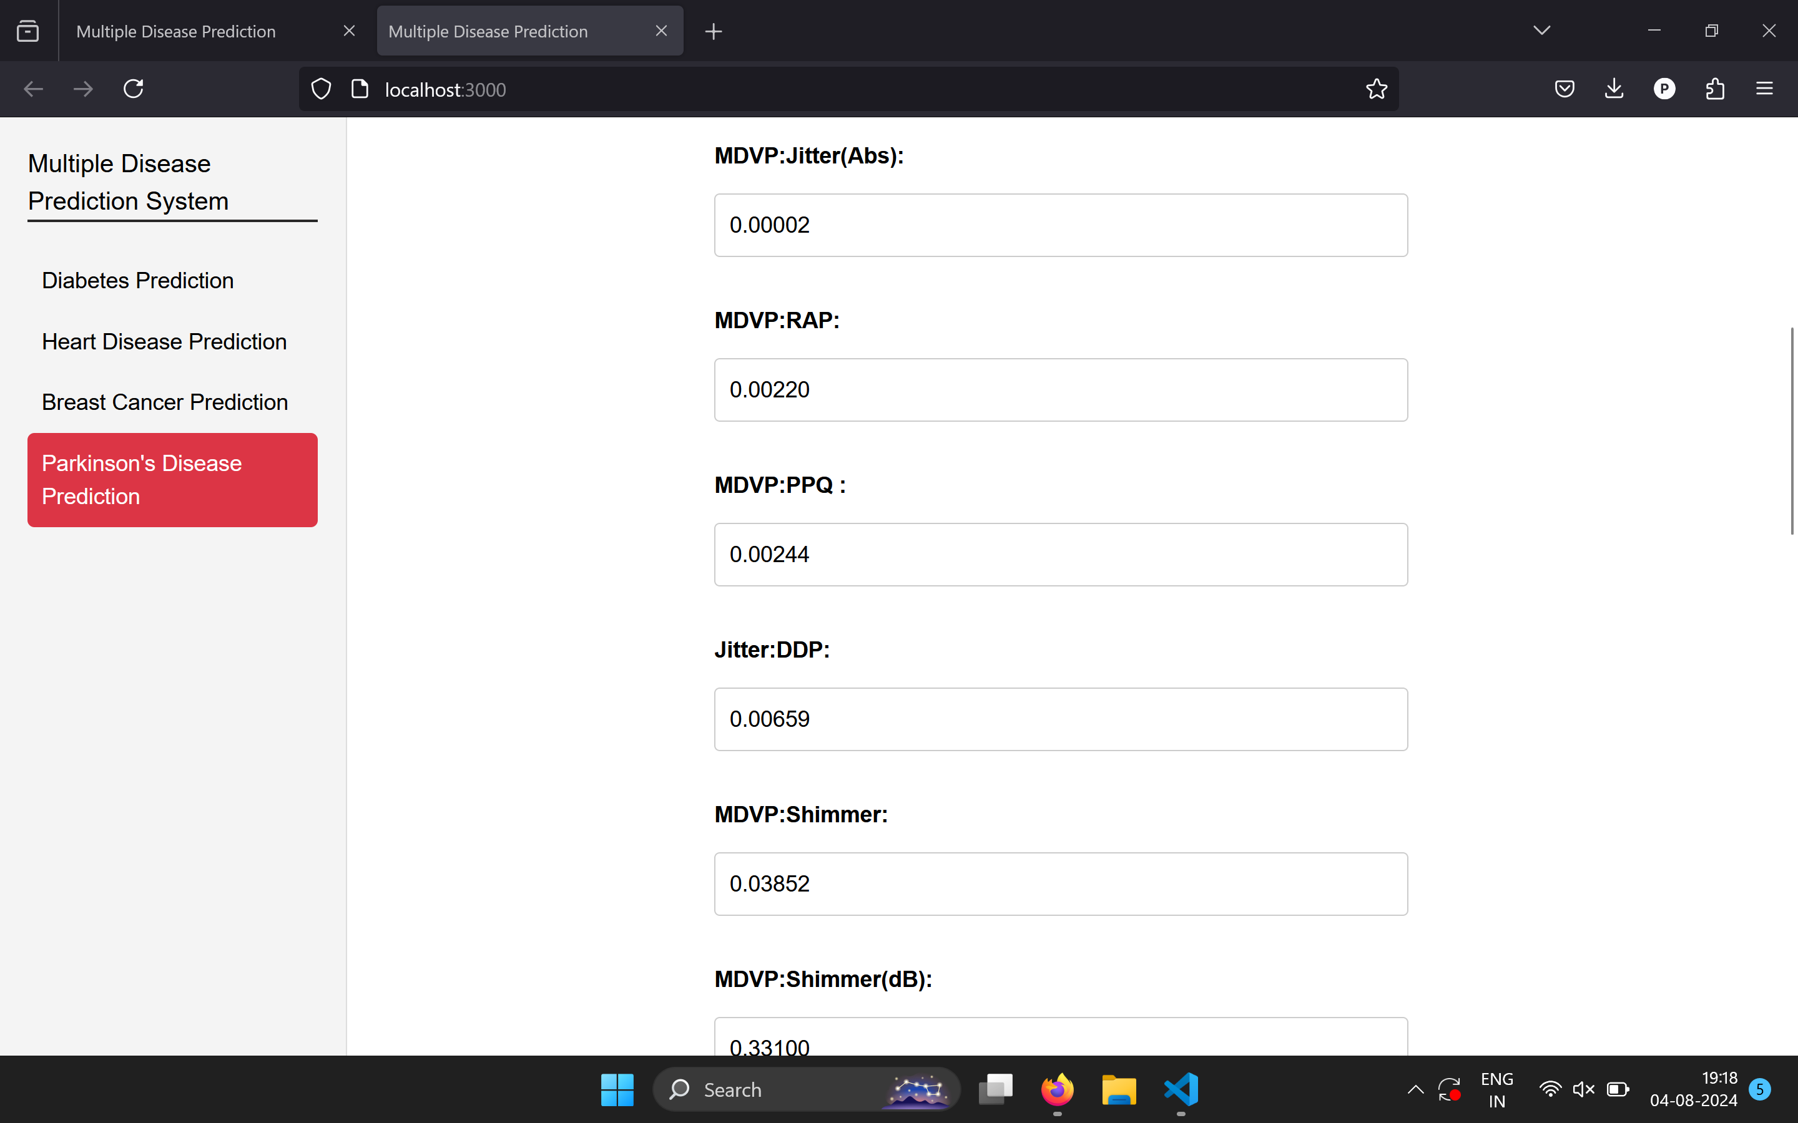
PARKINSON’S DISEASE
INPUTS

Slide 39
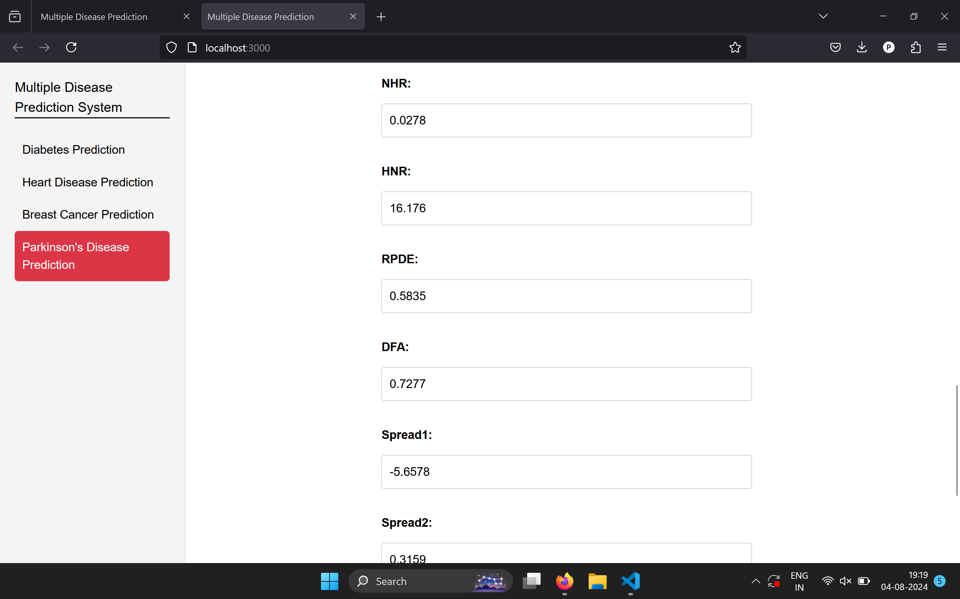

PARKINSON’S DISEASE

Slide 40
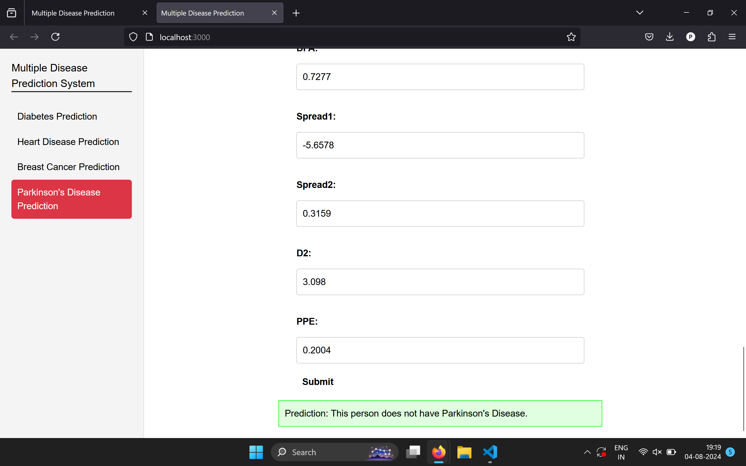
PARKINSON’S DISEASE
OUTPUT

Slide 41
FUTURE IMPROVEMENTS
Any inaccuracy in the model is a result of model underfitting. So gathering a sufficient data, and retraining the model with sufficient and relevant dataset is very important for improving accuracy.
Identifying and focusing on diseases that are prevalent or of significant concern, while also considering the development of models for less common diseases.
Conducting a thorough analysis to identify the most relevant features for disease prediction. Implementing advanced feature selection and extraction techniques to enhance model performance.
Collaborating with medical professionals to ensure that the features used in the models are clinically relevant and contribute to accurate predictions.
Continuously benchmarking the performance of the models against existing ones to identify areas for improvement and ensure that the system offers better or competitive accuracy is necessary.
The accuracy scores of the models are either a little better or almost exactly equal to existing models. So, there is a scope for identifying relevant machine learning models for predicting a specific disease.

Slide 42
CONCLUSION
The main objective of this research was to create a system that could reliably forecast several illnesses. The user is spared from having to visit multiple websites. Early diagnosis of diseases can both lengthen your life and spare you from financial hardship.
To achieve the highest level of accuracy, a variety of machine learning algorithms are used. In this study, investigation of the use of machine learning methods for the prognosis of various illnesses, with an emphasis on breast cancer, heart disease, diabetes, and Parkinson’s disease. Using the machine learning model with highest accuracy with their respective disease, a framework is created for multiple disease prediction. To guarantee data quality, information has been gathered from Kaggle.com and preprocessed it.
SVM algorithm obtained almost 90% accuracy for Parkinson's disease prediction, and 77% accuracy for diabetes prediction. Similarly, we used Naïve Bayes to predict Heart disease with an 85% accuracy rate. An accuracy of 80% was obtained when Breast cancer was predicted using Random Forest Classifier.
The results of this study show how machine learning has the power to trans- form illness prediction and enhance patient outcomes. Various machine learning model’s implementation required handling and filtering. When a trained model is included into an application, it may forecast diseases in real- world situations, enabling researchers, healthcare providers, and individuals to make well-informed decisions about managing and assessing disease risk. Targeted illness management techniques, individualized treatment regimens, and early interventions may all be made easier with the help of machine learning models for accurate disease prediction. It can improve patient care, help healthcare providers make well-informed decisions, and optimize the distribution of re- sources within healthcare systems. It also has potential for population-level disease surveillance, which would allow for the early identification of disease outbreaks and the application of preventative measures.
In summary, this study highlights the potential of machine learning in multiple disease prediction and advances the field of disease prediction using machine learning. We can get closer to developing more precise, timely, and individualized healthcare interventions by utilizing machine learning, which will ultimately enhance patient outcomes and create more effective healthcare systems.

